Slide 1
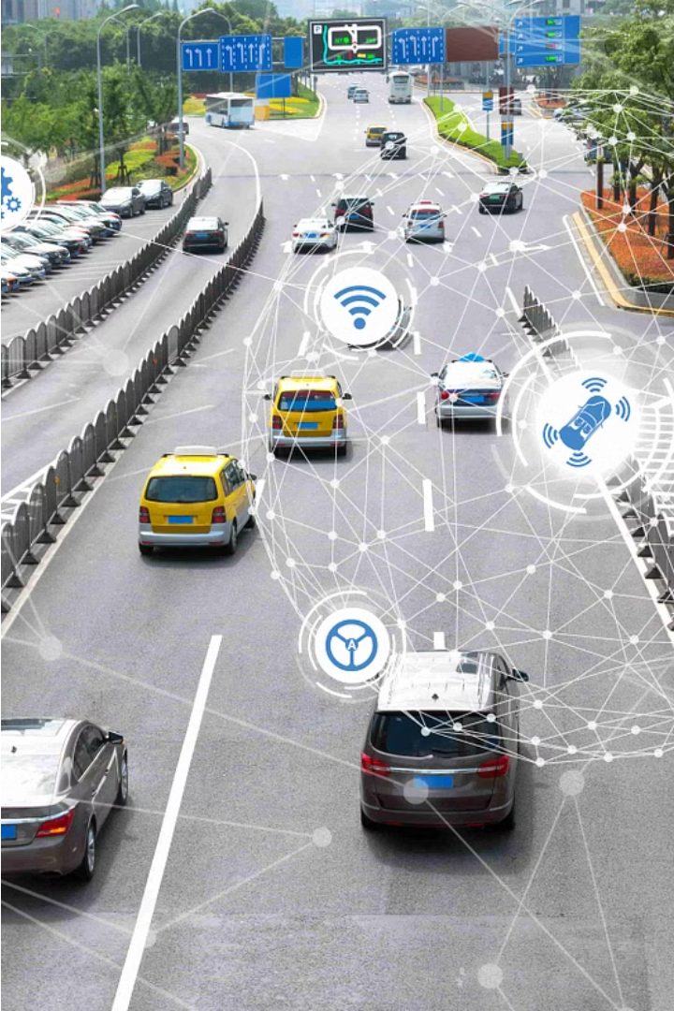
Smart Parking System
Done by,
AAKIL SHIHAF V (210701004)
AAKASH A (210701002)
ASHIK MOHAMMED Y (210701035)

Slide 2
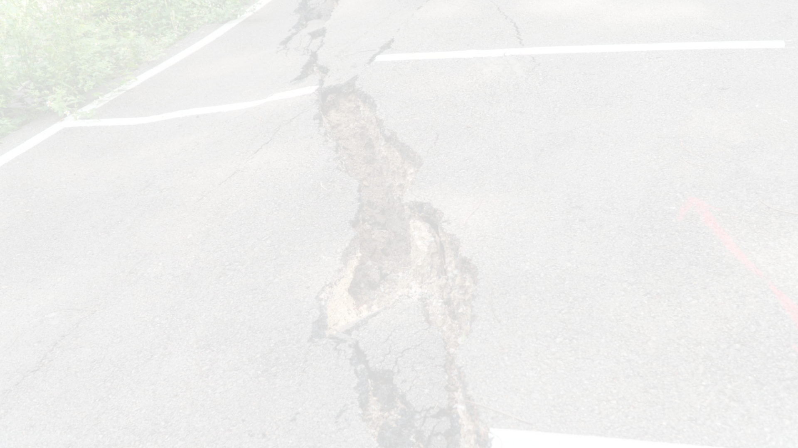
Problem Statement
1
Inefficient Parking Utilization
2
Time Waste
3
Revenue Losses
Drivers spend significant time searching for open spots, causing frustration and delays.
Parking lot operators miss out on potential revenue due to inefficient space management and lack of real-time data.
Traditional parking lots often have poor visibility of available spaces, leading to drivers circling endlessly and contributing to increased traffic and emissions.

Slide 3
Existing Parking System
Manual Monitoring
Parking lot attendants visually monitor spaces and direct drivers, which is labor-intensive and prone to human error. Along with this, it makes the whole environment more stressful during peak hours.
The current parking system primarily consists of conventional parking lots, metered parking spaces, and parking garages managed through manual ticketing or payment processes. These systems often lack real-time monitoring of parking availability, making it challenging for drivers to locate vacant spots efficiently.

Slide 4
Proposed Smart Parking System
Usage of Sensor Network
We make use of highly accurate IR(Infra-Red Sensors) to detect entering vehicles and leaving vehicles. Strategically placed sensors detect vehicle presence and availability in real-time, providing a comprehensive view of the parking lot.
We make use of this Sensor network to operate a servo motor powered barricade, to regulate parking along with an LCD display to show the real time parking slots available for the users.

Slide 5
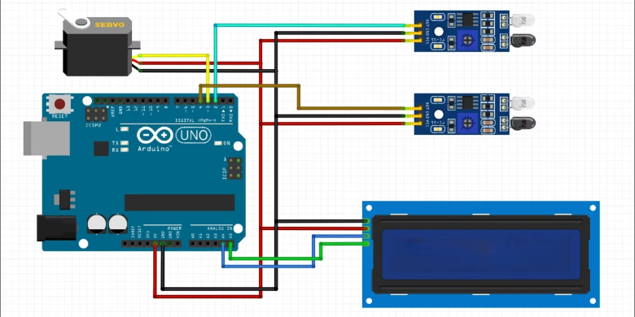



System Architecture
Circuit Diagram
Sensor Network
Data Collection
User Interface
IR sensors detect vehicle presence and availability in parking spaces.
Sensor data is transmitted to a central processing unit, such as an Arduino Uno.
A 16x2 LCD with I2C display provides real-time information to drivers.

Slide 6




Hardware Components
Arduino Uno
Servo Motor
IR Sensors
16x2 LCD with I2C
The microcontroller that processes sensor data and coordinates system operations.
Actuates the parking barrier gates to control vehicle entry and exit.
Detect the presence of vehicles in each parking space.
Displays real-time parking availability and guidance information for drivers.

Slide 7
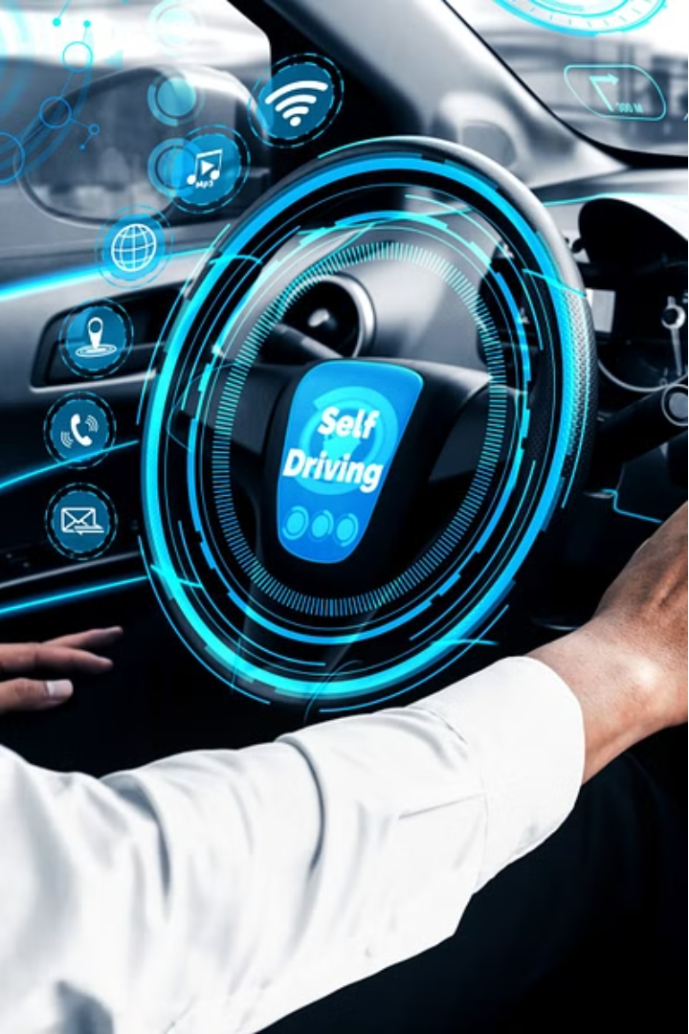
Conclusion
Smart parking systems offer a comprehensive solution to the challenges faced by traditional parking infrastructure. By leveraging advanced technologies, these systems optimize parking utilization, enhance the driver experience, and provide valuable data to parking lot operators.

